Slide 1
Clustering Algorithms and Dimensionality Reduction
Atul Kahate
https://www.linkedin.com/in/atulkahate/

Slide 2
Density-Based Clustering and DBSCAN
Groups points that are closely packed together and treats sparse points as noise (outliers)
  Clusters = High-density regions
  Noise = Low-density regions
DBSCAN (Density-Based Spatial Clustering of Applications with Noise)
  Most popular density-based clustering algorithm
Simple Intuition
  Think of people standing on a field
    Crowded groups → clusters
    Isolated people → noise
  DBSCAN finds the crowds, ignores loners
Use: Spatial data (GPS, maps), Anomaly detection, Image segmentation, When cluster shapes are irregular

Slide 3
DBSCAN Working
Key parameters
  ε (epsilon): Radius of neighborhood around a point
  MinPts: Minimum number of points required inside ε to form a dense region
Types of points
  Core point: Has ≥ MinPts points within ε
  Border point: Has < MinPts points, but lies within ε of a core point
  Noise (outlier): Not within ε of any core point
Working
  Pick an unvisited point
  Check its ε-neighborhood
  If points ≥ MinPts → mark as core point
  Form a cluster and expand it by visiting neighbors
  If points < MinPts → mark as noise
  Repeat until all points are processed
Example (2D points)
  ε = 1.0
  MinPts = 5
  If a point has 5 or more neighbors within radius 1.0, it starts a cluster

Slide 4
DBSCAN
Step 1: Choose DBSCAN parameters
ε (epsilon) → how close dogs must be in weight, say 2 kg
MinPts → minimum dogs needed to form a group, say 3 dogs
Meaning: At least 3 dogs within ±2 kg → dense region → cluster
Step 3: Border points
None in our dataset
But what if had a dog with weight 18 kg?
Not enough neighbors to be core
But close to light-dog cluster
Border point
Included in Cluster 1
Dog | Weight (kg) | Obese (y)
D1 | 9 | No
D2 | 10 | No
D3 | 11 | No
D4 | 12 | No
D5 | 13 | No
D6 | 26 | Yes
D7 | 27 | Yes
D8 | 28 | Yes
D9 | 29 | Yes
D10 | 30 | Yes
D11 | 45 | Yes
Step 4: Noise/Outliers
Dog with weight 45 kg
No nearby dogs
DBSCAN labels it as an outlier
** DBSCAN is great for anomaly detection **
Step 2: Look at local neighbourhoods
Now DBSCAN will scan each dog
Light dogs 9, 10, 11, 12, 13
Each dog has many neighbors within 2 kg
Core points
DBSCAN forms Cluster 1 (light dogs)
Heavy dogs 26, 27, 28, 29, 30
Each dog has many neighbors within 2 kg
Core points
DBSCAN forms Cluster 2 (heavy dogs)
Step 5: Final clusters
Cluster 1: Light-weight dogs
Cluster 2: Heavy-weight dogs
Noise: Extremely unusual weights
Step 0: Understanding data
Each dog is a data point
We use X-axis: Weight (kg)
Hint: Imagine points placed on a number line based on weight
Summary: DBSCAN groups dogs with similar weights based on density, automatically finds light and heavy groups, and flags unusually weighted dogs as outliers—without using the obesity label
Step 6: Interpret clusters
Cluster | Observation
Light-weight cluster | Mostly Obese = No
Heavy-weight cluster | Mostly Obese = Yes
Noise | Abnormal cases
DBSCAN discovers structure first, labels later

Slide 5
Clustering Mixed Data
Basic idea: Almost all clustering algorithms are based on one idea: Similar points should be “close” to each other
Result: They need a way to answer: “How far apart are two data points?”
The “how far” is distance
Numeric data, no problem
  Height A = 170 cm, Height B = 175 cm, Distance = |170 − 175| = 5
Categorical/Non-numeric data, problem
  City A = Mumbai, City B = Delhi, Distance = ?
  What if we encode Mumbai = 1, Delhi = 2, Chennai = 3?
    Result: Chennai is “twice as far” from Mumbai as Delhi => Meaningless!
    Solution
      Same category: Distance = 0, Different category: Distance = 1
      Example: Mumbai -> Mumbai distance = 0, Mumbai -> Delhi distance = 1, Mumbai -> Chennai distance = 1

Slide 6

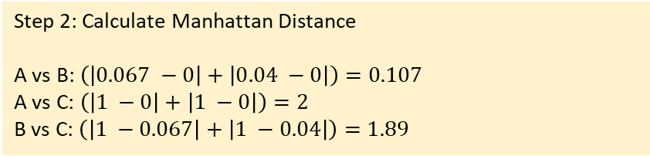
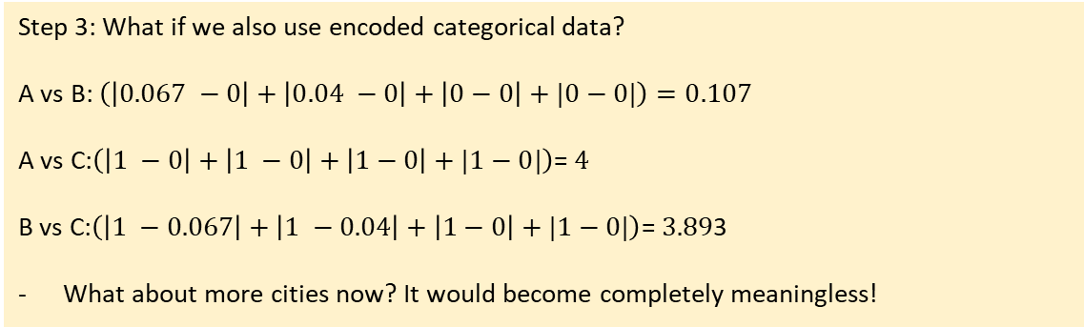
Manhattan Distance (L1) - Taxicab path
Distance between two points in a grid-based system (like streets in a city laid out in a grid)
Represents how a taxi would drive along streets (only horizontal and vertical moves) rather than "as the crow flies."
Step 2: Calculate Manhattan Distance
A vs B: $\left(\left|0.067 −0\right|+\left|0.04 −0\right|\right)=0.107$
A vs C: $\left(\left|1 −0\right|+\left|1 −0\right|\right)=2$
B vs C: $\left(\left|1 −0.067\right|+\left|1 −0.04\right|\right)=1.89$
Person | Age | Income (₹k) | Gender | City
A | 25 | 30 | M | Pune
B | 27 | 32 | M | Pune
C | 55 | 80 | F | Mumbai
Interpretation
Pair | Distance
A–B | 0.107 (very close)
A–C | 2 (far)
B–C | 1.89 (far)
Step 1: Find ranges for numeric types
Age: Min: 25, Max: 55, Range: 30
Inc: Min: 30, Max: 80, Range: 50
Step 3: What if we also use encoded categorical data?
A vs B: $\left(\left|0.067 −0\right|+\left|0.04 −0\right|+\left|0−0\right|+|0−0|\right)=0.107$
A vs C:$\left(\left|1 −0\right|+\left|1 −0\right|+\left|1−0\right|+|1−0|\right)$= $4$
B vs C:$\left(\left|1 −0.067\right|+\left|1 −0.04\right|+\left|1−0\right|+|1−0|\right)$= $3.89$3
What about more cities now? It would become completely meaningless!
Normalized and Scaled data
Person | Age | Income | Gender | City
A | 0 | 0 | 0 | 0
B | 0.067 | 0.04 | 0 | 0
C | 1 | 1 | 1 | 1
Conclusion: Fails for categorical data

Slide 7
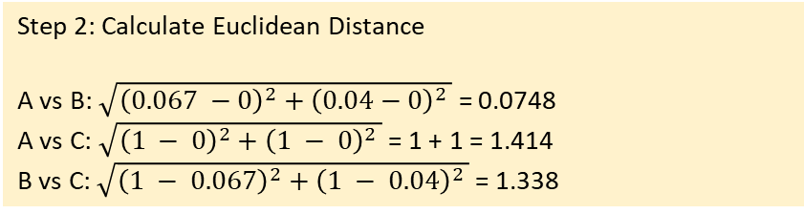
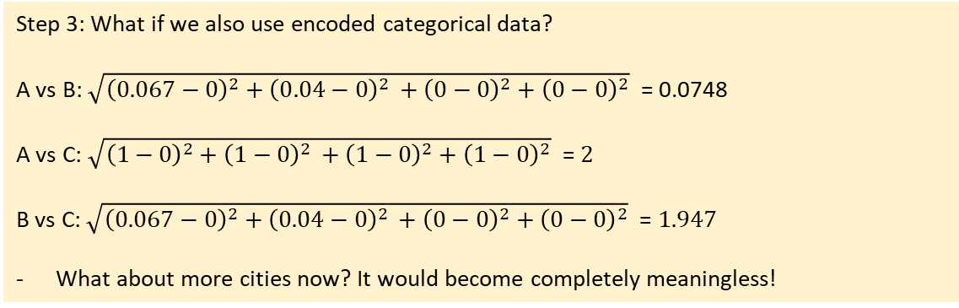
Euclidean Distance (L2) – Shortest Path
“As the crow flies”
Straight line distance between two points
Works only for numeric data of similar scales
Step 2: Calculate Euclidean Distance
A vs B: $\sqrt{{\left(0.067 −0\right)}^{2}+{\left(0.04−0\right)}^{2 }}$ = 0.0748
A vs C: $\sqrt{{\left(1 − 0\right)}^{2}+{\left(1 − 0\right)}^{2 }}$ = 1 + 1 = 1.414
B vs C: $\sqrt{{\left(1 − 0.067\right)}^{2}+{\left(1 − 0.04\right)}^{2 }}$ = 1.338
Person | Age | Income (₹k) | Gender | City
A | 25 | 30 | M | Pune
B | 27 | 32 | M | Pune
C | 55 | 80 | F | Mumbai
Interpretation
Pair | Distance
A–B | 0.0748 (very close)
A–C | 1.414 (far)
B–C | 1.338 (far)
Step 1: Find ranges for numeric types
Age: Min: 25, Max: 55, Range: 30
Inc: Min: 30, Max: 80, Range: 50
Step 3: What if we also use encoded categorical data?
A vs B: $\sqrt{{\left(0.067−0\right)}^{2}+{\left(0.04−0\right)}^{2 }+{\left(0−0\right)}^{2}+{\left(0−0\right)}^{2}}$ = 0.0748
A vs C: $\sqrt{{\left(1−0\right)}^{2}+{\left(1−0\right)}^{2 }+{\left(1−0\right)}^{2}+{\left(1−0\right)}^{2}}$ = $2$
B vs C: $\sqrt{{\left(0.067−0\right)}^{2}+{\left(0.04−0\right)}^{2 }+{\left(0−0\right)}^{2}+{\left(0−0\right)}^{2}}$ = $1.947$
What about more cities now? It would become completely meaningless!
Normalized and Scaled data
Person | Age | Income | Gender | City
A | 0 | 0 | 0 | 0
B | 0.067 | 0.04 | 0 | 0
C | 1 | 1 | 1 | 1
Conclusion: Fails for categorical data

Slide 8

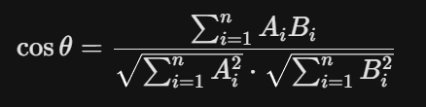
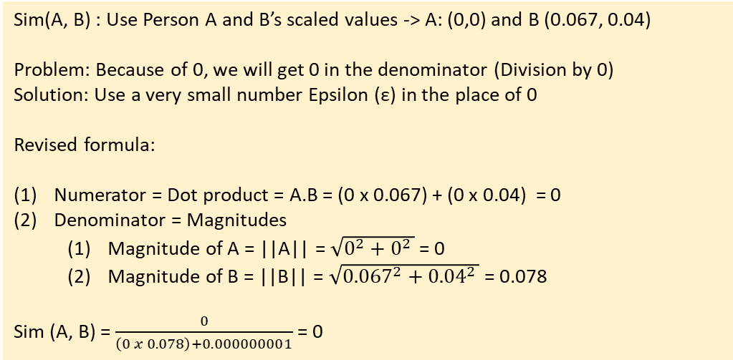
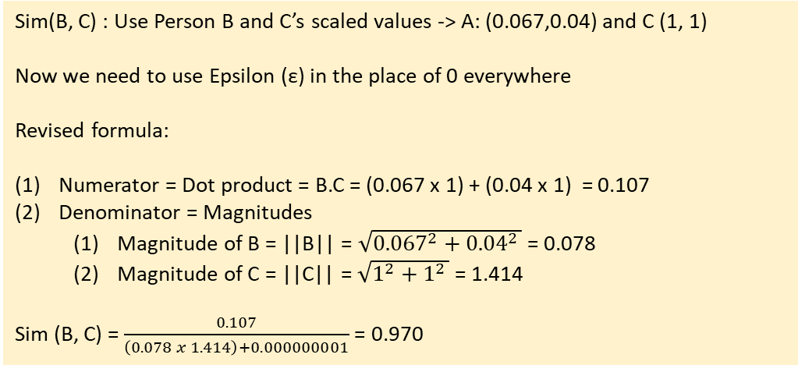
Cosine Similarity – Angle Difference
Measures the angle (cosine) between two values
Widely used for text similarity search
Sim(A, B) : Use Person A and B’s scaled values -> A: (0,0) and B (0.067, 0.04)
Problem: Because of 0, we will get 0 in the denominator (Division by 0)
Solution: Use a very small number Epsilon (ε) in the place of 0
Revised formula:
Numerator = Dot product = A.B = (0 x 0.067) + (0 x 0.04) = 0
Denominator = Magnitudes
  Magnitude of A = ||A|| = $\sqrt{0^{2}+0^{2 }}$ = 0
  Magnitude of B = ||B|| = $\sqrt{{0.067}^{2}+{0.04}^{2 }}$ = 0.078
Sim (A, B) = $\frac{0}{\left(0 x 0.078\right)+0.000000001}$ = 0
Person | Age | Income (₹k) | Gender | City
A | 25 | 30 | M | Pune
B | 27 | 32 | M | Pune
C | 55 | 80 | F | Mumbai
Cosine Similarity formula
Meaning: Dot product divided by product of magnitudes
Sim(B, C) : Use Person B and C’s scaled values -> A: (0.067,0.04) and C (1, 1)
Now we need to use Epsilon (ε) in the place of 0 everywhere
Revised formula:
Numerator = Dot product = B.C = (0.067 x 1) + (0.04 x 1) = 0.107
Denominator = Magnitudes
  Magnitude of B = ||B|| = $\sqrt{{0.067}^{2}+{0.04}^{2 }}$ = 0.078
  Magnitude of C = ||C|| = $\sqrt{1^{2}+1^{2 }}$ = 1.414
Sim (B, C) = $\frac{0.107}{\left(0.078 x 1.414\right)+0.000000001}$ = 0.970
Interpretation
Pair | Cosine Similarity
A–B | 0 (very different)
B–C | 0.970 (very similar)
But this is WRONG!
Happens because scaling made A = 0
Conclusion: Do not use Cosine Similarity here

Slide 9
Comparison
Feature | Manhattan (L1) | Euclidean (L2) | Cosine Similarity
Geometry | Grid-based (Taxicab) | Straight-line (Crow flies) | Angular difference
Sensitivity | Robust to outliers | Sensitive to outliers | Magnitude independent
Calculation | Sum of absolute diffs | Square root of Sum of squares | Dot product / Magnitudes
Best Used For | High-dimensional data | Physical/dense distance | Text embeddings / RAG
Intuition | Moving along axes | Direct physical gap | Shared "theme" or ratio
Example comparison | Data Reality | Distance (L1/L2) Says... | Cosine Says...
A vs B | Very Similar | Correct: "These are close" | Fails: "No direction (0)"
B vs C | Very Different | Correct: "These are far" | Misleading: "Same pattern (0.97)"

Slide 10
Gower Distance
Works by calculating a "partial score" (s) for each feature and then averaging them:
  Numeric data (Age, Income): Variation of Min-Max scaling is used to find the difference
  Categorical data (Gender, City): Uses a simple Boolean check
    Similar values -> Distance = 0 (e.g. Pune-Pune)
    Different values -> Distance = 1 (e.g. Pune-Mumbai)
  Result: Combines these into a single score between 0 and 1, where 0 is identical and 1 is completely different
Best for mixed data

Slide 11

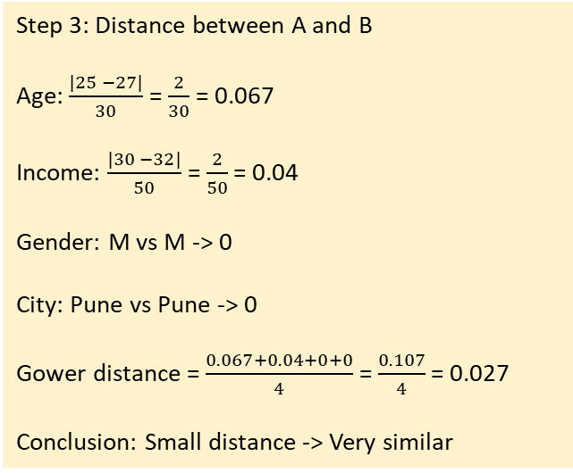
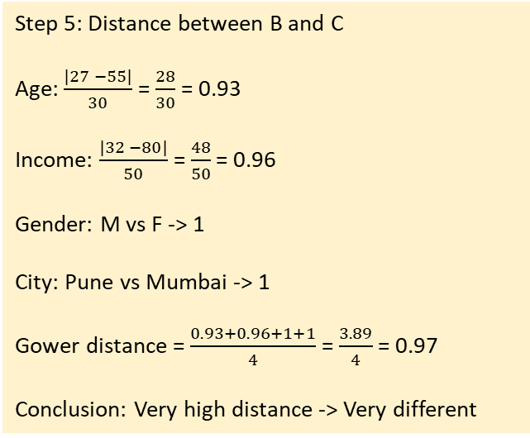
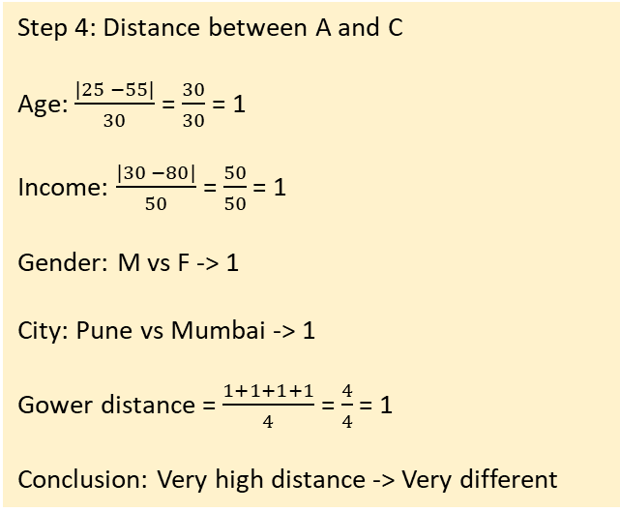
Gower Distance
Step 3: Distance between A and B
Age: $\frac{|25 −27|}{30}$ = $\frac{2}{30}$ = 0.067
Income: $\frac{|30 −32|}{50}$ = $\frac{2}{50}$ = 0.04
Gender: M vs M -> 0
City: Pune vs Pune -> 0
Gower distance = $\frac{0.067+0.04+0+0}{4}$ = $\frac{0.107}{4}$ = 0.027
Conclusion: Small distance -> Very similar
Step 5: Distance between B and C
Age: $\frac{|27 −55|}{30}$ = $\frac{28}{30}$ = 0.93
Income: $\frac{|32 −80|}{50}$ = $\frac{48}{50}$ = 0.96
Gender: M vs F -> 1
City: Pune vs Mumbai -> 1
Gower distance = $\frac{0.93+0.96+1+1}{4}$ = $\frac{3.89}{4}$ = 0.97
Conclusion: Very high distance -> Very different
Handles numeric, categorical, binary data
Scales everything to [0,1]
Combines distances feature-wise
Person | Age | Income (₹k) | Gender | City
A | 25 | 30 | M | Pune
B | 27 | 32 | M | Pune
C | 55 | 80 | F | Mumbai
Step 1: Identify feature types
Feature | Type | How distance is computed
Age | Numeric | normalized absolute difference
Income | Numeric | normalized absolute difference
Gender | Categorical | 0 if same, 1 if different
City | Categorical | 0 if same, 1 if different
Step 4: Distance between A and C
Age: $\frac{|25 −55|}{30}$ = $\frac{30}{30}$ = 1
Income: $\frac{|30 −80|}{50}$ = $\frac{50}{50}$ = 1
Gender: M vs F -> 1
City: Pune vs Mumbai -> 1
Gower distance = $\frac{1+1+1+1}{4}$ = $\frac{4}{4}$ = 1
Conclusion: Very high distance -> Very different
Final Gower matrix
 | A | B | C
A | 0.00 | 0.027 | 1.00
B | 0.027 | 0.00 | 0.97
C | 1.00 | 0.97 | 0.00
Step 2: Find ranges for numeric types
Age: Min: 25, Max: 55, Range: 30
Inc: Min: 30, Max: 80, Range: 50
A-B differ slightly in age/income → tiny distance
A-C differ in everything → distance = 1
B-C almost as different as A-C → close to 1

Slide 12
When to Use What
# | Use case | Use | Reason
1 | k-NN on numeric data (height, weight, age) | Euclidean | Straight-line distance works well
2 | Grid-based data (city blocks, pixels) | Manhattan | Movement happens step-by-step
3 | Sparse text vectors (TF-IDF) | Cosine | Direction matters, not magnitude
4 | Word / sentence embeddings | Cosine | Captures semantic similarity
5 | Mixed data (age, income, gender, city) | Gower | Handles numeric + categorical
6 | Features with different scales (unscaled) | Manhattan | Less sensitive to outliers
7 | Image pixel comparison | Euclidean | Pixel intensity differences
8 | Document similarity (short vs long docs) | Cosine | Length-independent similarity
9 | Customer similarity (real-world data) | Gower | Real data is mixed-type
10 | Anomaly detection (numeric features) | Euclidean / Manhattan | Large distances flag anomalies

Slide 13
Dimensionality
Reduction
Tool | Core Philosophy | Best Use Case
PCA | Captures "Spread" (Variance) | Pre-processing and Noise reduction
t-SNE | Preserves "Who is close" | Identifying clusters visually
UMAP | Preserves "Who is close" AND "How far" | Large-scale data visualization
Reducing the number of features (dimensions) in data without losing important information
  Keeping the signal, removing the noise and redundancy
Curse of dimensionality: Distance measures (Euclidean, Manhattan, etc.) become meaningless as dimensions grow
Redundant features: Many features carry the same information (e.g., height in cm and inches)
Overfitting: Too many features → model memorizes instead of learning
Computation and visualization: Hard to train models and impossible to visualize beyond 3D
Two types
  Feature selection: Keep some features, drop the others – No transformation
  Feature extraction: Create new features by transforming data into fewer dimensions

Slide 14
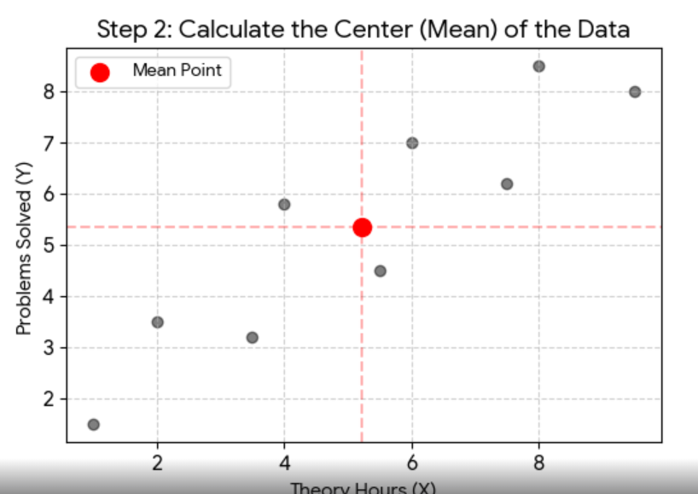
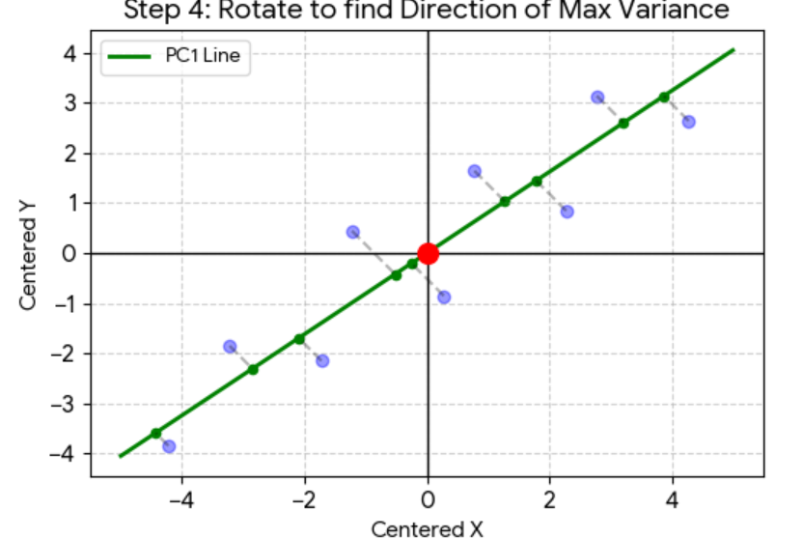
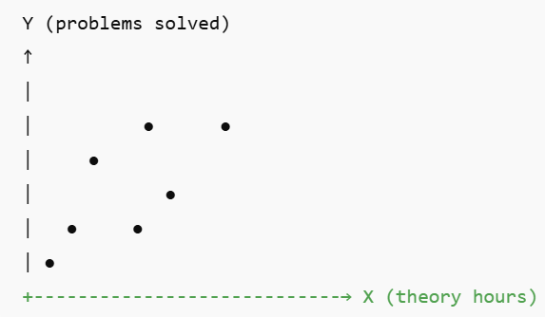
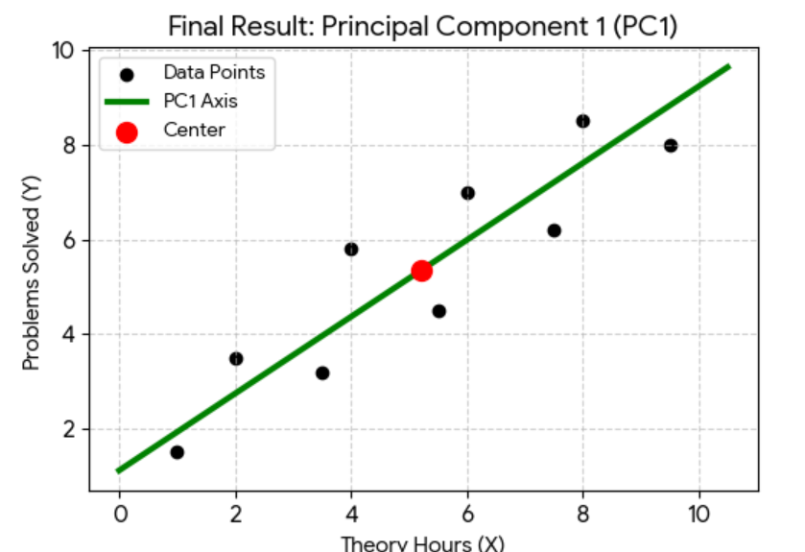
Principal Component Analysis (PCA)
Step 2: Find the Center (Mean):
Calculate Mean(X) and Mean(Y)
This point () = “Center of gravity” for our data -> All PCs must pass through it
Unsupervised
Finds directions of maximum variance
New features = Linear combinations of old ones
Example: Original features = (height, weight, waist, BMI)
PC1 = overall body size
PC2 = body shape
Step 3/4: The “Best fit” rotation
Imagine a line passing through this point
PCA “rotates” it till two equivalent conditions are satisfied
Maximum variance: When we project the line, data points should be as spread out as possible
Minimum distance: Squared perpendicular distances
Step 1: Plot all the points
X = Hours of theory study
Y = Practical problems solved
Some students
Study a lot, solve less
Solve a lot, study less
Are inconsistent
Summary
Points are scattered
Trend exists, but it is noisy
Not all students behave the same
PCA does not force a perfect line
It asks: In which direction does the data vary the most, overall?
PC1 (Overall academic effort) = Distance from the “average” student
Captures the most important trend – Students who study more theory hours also tend to solve more practical problems = (w1 x Theory) + (w2 x Practical)
We have “compressed” two features into one component
Student | Theory Hours (X) | Problems Solved (Y) | PC1 Value (The "Summary")
1 | 1.0 | 1.5 | -5.83
2 | 2.0 | 3.5 | -3.95
3 | 3.5 | 3.2 | -2.88
4 | 4.0 | 5.8 | -0.95
5 | 5.5 | 4.5 | -0.45
6 | 6.0 | 7.0 | 1.35
7 | 7.5 | 6.2 | 1.94
8 | 8.0 | 8.5 | 3.77
9 | 9.5 | 8.0 | 5.00

Slide 15
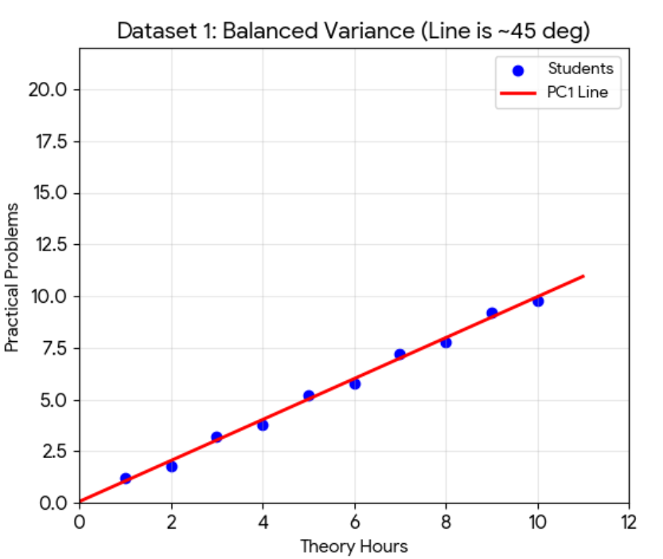
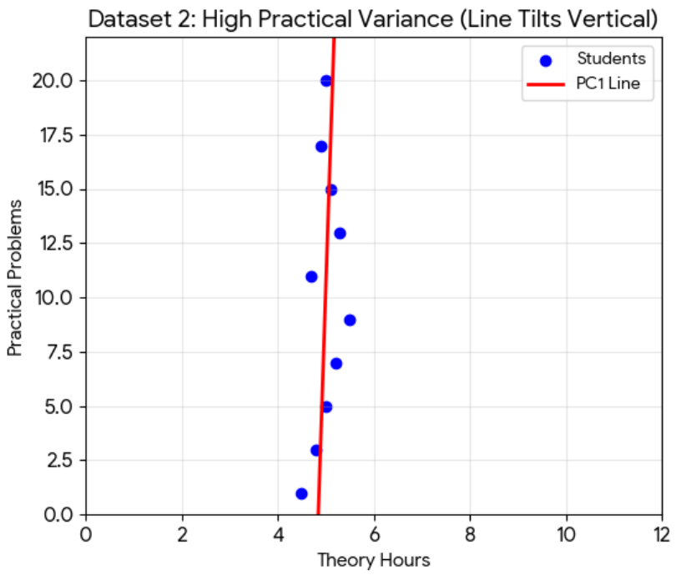
How PCA Captures the “Most Variance”
Similar variance in Theory and Practical Hours (Diagonal between X and Y axes) => w1 ≈ w2
Much more variance in Practical Hours (Tilting towards the Y-axis) => w2 will be much stronger than w1

Slide 16
t-SNE and UMAP
t-SNE (t-Distributed Stochastic Neighbour Embedding)
  Keeps "Friends" Together: It focuses on keeping points that are close to each other in high dimensions close together in the simplified view
  Ignores "The Big Picture": It does not care about the total distance across the whole map; it only cares about our immediate surroundings
UMAP (Uniform Manifold Approximation and Projection)
  Best of Both Worlds: It preserves local "neighborhoods" (like t-SNE) while also respecting the "big picture" global structure (like PCA)
  Fast and Scalable: It is significantly faster than t-SNE, making it the better choice for massive datasets or real-time agentic workflows
  True to Distance: Unlike t-SNE, the distance between clusters in UMAP actually has meaning, helping us see how related different groups truly are

Slide 17
When to Use What
# | Use case | Use | Reason
1 | Reduce 100 features before regression | PCA | Removes redundancy while keeping variance
2 | Visualize word embeddings (Word2Vec, BERT) | t-SNE | Shows local similarity clearly
3 | Visualize MNIST digits | t-SNE | Excellent cluster separation
4 | Large embedding dataset (100k+ points) | UMAP | Faster and more scalable
5 | Preprocessing before clustering (k-means) | PCA | Reduces noise, keeps structure
6 | Visualize customer segments | UMAP | Preserves neighborhood + global layout
7 | Detect outliers in high-dimensional data | PCA | Extreme projections stand out
8 | One-off EDA plot for presentation | t-SNE | Produces visually clear plots
9 | Incremental visualization (new data later) | UMAP | Can transform new points
10 | Compress image features before model | PCA | Linear, fast, model-friendly

